Slide 1
Hospital Redevelopment Performance Measurement Plan
Group 6: Afreen Rehman, Hemantika Mahesh Kumar, Kennedy Ojowi, Pooja Sharma and Rachael Beaver
October 21st 2024

Slide 2
Presentation Outline
01
02
03
04
Background
Analysis: Literature Review
Proposed Indicators
Recommendation and Next Steps

Slide 3
01
Background

Slide 4
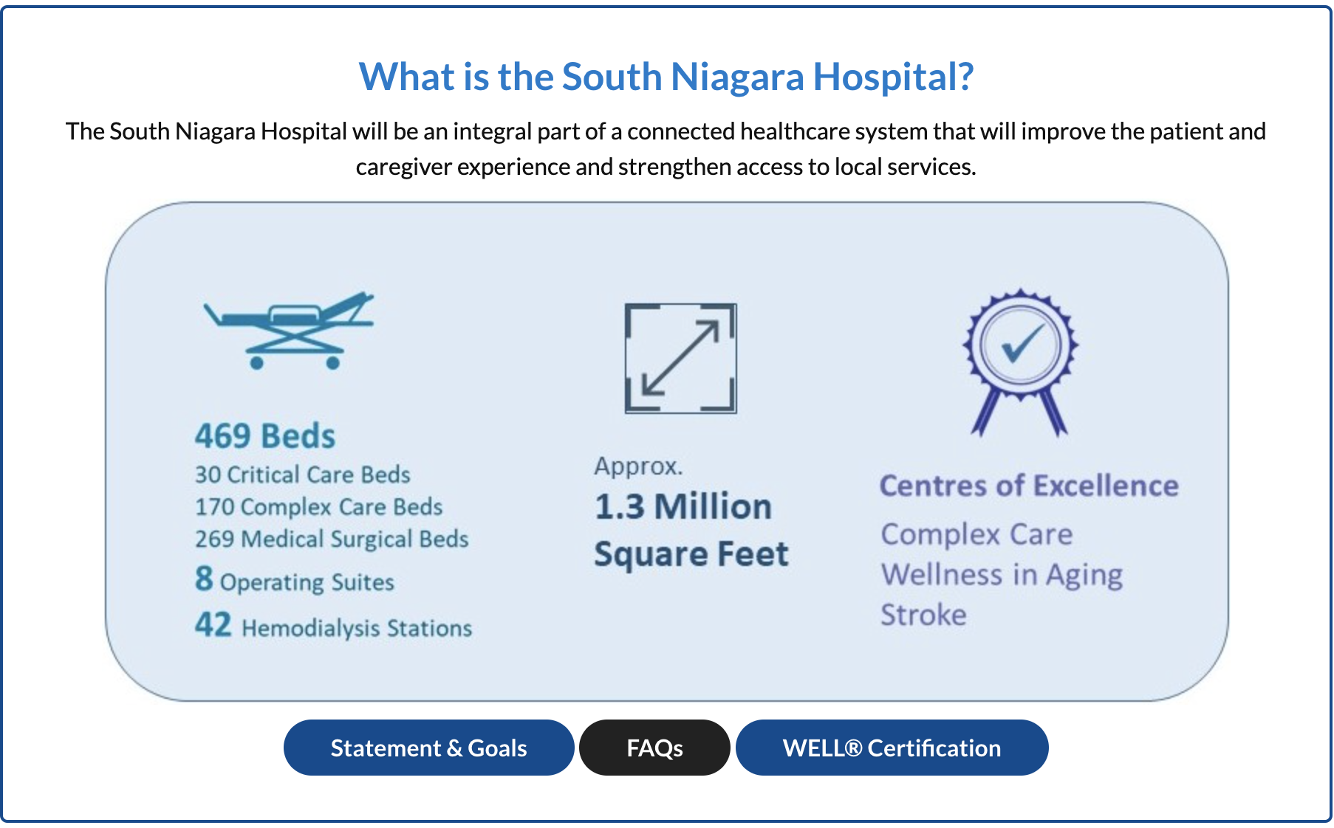
Notes:
The South Niagara Hospital construction has begun with plans to become a 1.3 million square foot hospital that has 469 beds, including critical and complex care. There are plans in place to be a Centre of Excellence in Complex Care, Wellness in Aging, and Stroke.

Slide 5
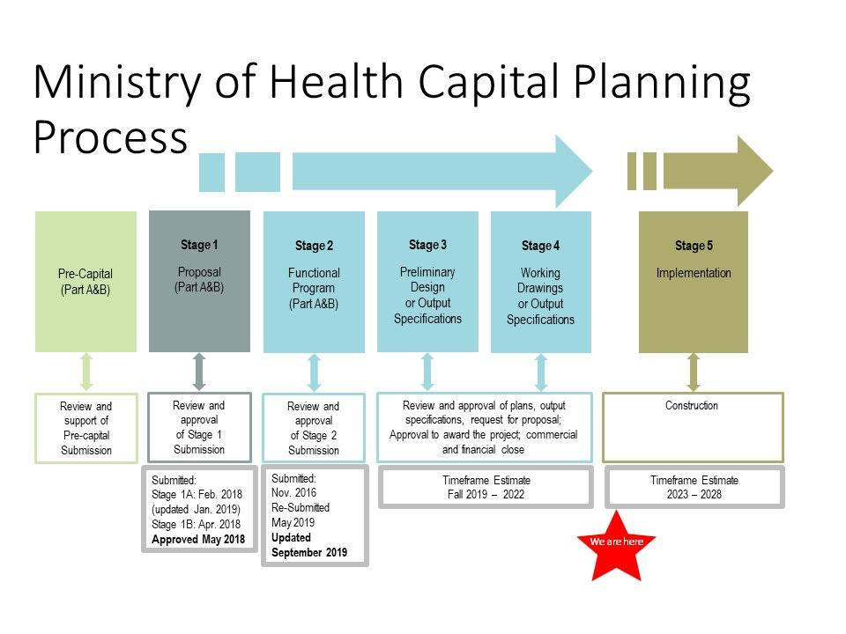
Notes:
After an extensive approval and planning process, construction has begun in 2023 to build the new South Niagara Hospital. The Ministry of Health has been heavily involved throughout the planning process, to ensure fulfillment of their mandate has been achieved. The Ministry has been a key part in improving outcomes and contributing to healthier communities.

Slide 6


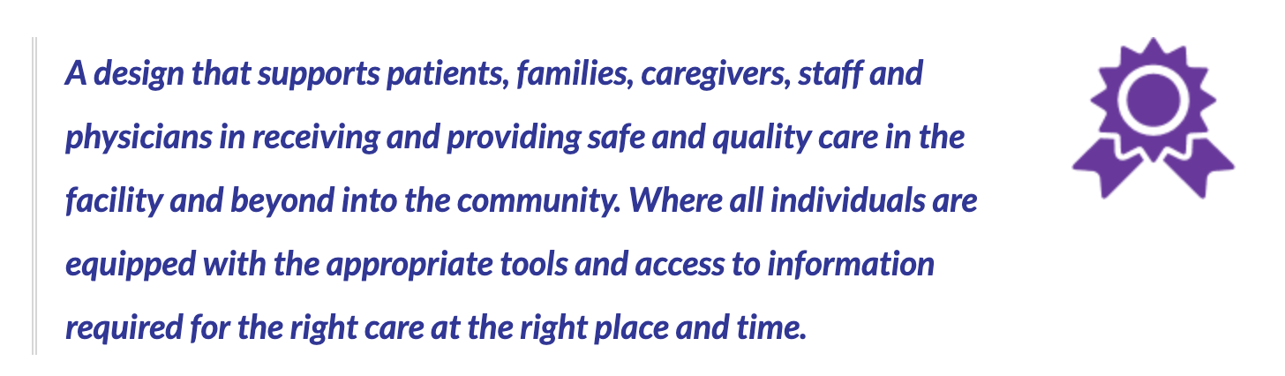
Notes:
Project goals were created to include 6 building blocks in order to meet the needs of the community.
The first three building blocks include patient, family, and staff experience, connectedness, and operational excellence. The project team has taken steps to meet these goals such as meeting with the Niagara Ontario Health Team (OHT) to strengthen community resources. As well as creating an auditorium and outdoor space for gatherings.

Slide 7



Notes:
The South Niagara Site (NSN) has taken extra steps in the design and planning process to ensure an accessible and inclusive facility. There are also efforts to be leaders in environmental sustainability, and to be adaptable, flexible, and responsible.

Slide 8
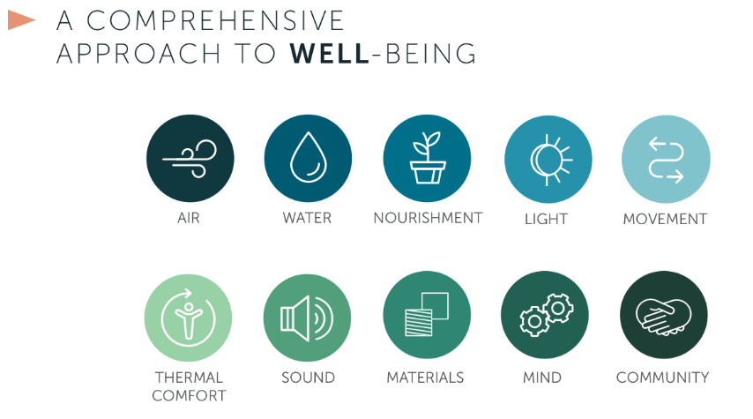
Notes:
As of September 2024, Niagara Health announced that the South Niagara Hospital Project achieved WELL Pre-certification. Full certification would be awarded after opening day.
The Well Certification is a scientifically developed verified tool to help design buildings and measure/monitor their impact on the health and well-being of the occupants. The WELL certification is a world-recognized award in architectural and building communities. The certification is based on the 10 concepts as seen in the slide. With this certification, the South Niagara Hospital will be identified as featuring concepts aiming to improve building design, operations, and the overall impact on the occupants’ specific body systems such as cardiovascular, digestive, etc.

Slide 9
02
Analysis
Literature review on EBD’s process, key elements, benefits, case studies and application.

Slide 10
Introduction to Evidence Based Design (EBD) in Hospitals
EBD is an approach that utilizes credible research and data to inform decisions about the built environment.
It aims to improve patient outcomes, safety, and overall healthcare quality.
Notes:
EBD is an approach that utilizes credible research and data to inform decisions about the built environment, aiming to improve patient outcomes, safety, and overall healthcare quality. By systematically defining goals, interpreting relevant research, and innovating design concepts, EBD creates healing environments that support patients, families, and staff. For South Niagara Hospital, applying these principles is crucial to ensuring that its redevelopment meets both the immediate and future healthcare needs of the community.
Next we will look at the process of coming up with EBD.

Slide 11
Five Core Steps of the EBD Process
Find and Critically Interpret Relevant Research
Collect Baseline Performance Measures and Monitor Implementation
Step 2
Step 4
Step 1
Step 3
Step 5
Define Evidence-Based Goals and Objectives
Create Innovative Design Concepts based on interpreted evidence
Evaluation of Post-Occupancy Performance
Notes:
Based on the literature review, I'd like to share the five core steps of the Evidence-Based Design (EBD) process, which is essential for creating effective healthcare environments.
In Step 1: We start by establishing clear, measurable goals based on the desired outcomes of the project. This includes formulating hypotheses about how specific design elements will impact those outcomes.
Next, we identify credible studies and data to inform our design decisions. We critically analyze this research to ensure it's relevant and applicable to our specific context.
In Step 3: Using the interpreted evidence, we develop innovative design solutions. These concepts align with our project's goals and are grounded in solid research findings.
In Step 4: We gather data on current performance to establish a benchmark. As we implement the design, we monitor the process closely to ensure it's executed as planned, making adjustments when necessary.
Finally in Step 5, we evaluate the effectiveness of the design by comparing pre- and post-implementation data. This assessment helps us determine if we've met our original goals and identifies areas for future improvement.

Slide 12
Key Focus Areas of EBD
Safety and Infection Control
Stress Reduction
Staff Effectiveness
Patient and Family Support
Single Patient Rooms
Sound-Absorbing Materials
Improved Air Quality
Access to Nature
Natural Light
Quiet Environments
Ergonomic Equipment and Furniture
Centralized and Decentralized Nurse Stations
Family Zones in Patient Rooms
Comfortable Public Areas
Notes:
Evidence-based design in healthcare has identified key features that consistently improve patient care and staff efficiency. These features focus on creating healing environments through four main areas. First, safety and infection control are enhanced by using single patient rooms to reduce hospital-acquired infections, incorporating sound-absorbing materials to lower stress-inducing noise, and improving air quality with low-toxicity materials and advanced ventilation. Second, stress reduction is achieved by providing access to nature through windows, gardens, and art, maximizing natural light exposure to regulate circadian rhythms, and designing quiet spaces to minimize anxiety. Third, staff effectiveness is boosted by using ergonomic equipment to reduce physical strain, balancing centralized and decentralized nurse stations for efficient communication and patient accessibility, and improving sightlines for better patient monitoring. Finally, patient and family support is prioritized by including family zones in patient rooms to encourage involvement in care and creating comfortable public areas with flexible seating and amenities for visitors. These evidence-based design elements work together to create a holistic healing environment that benefits patients, staff, and visitors alike, ultimately leading to better health outcomes and more efficient healthcare delivery.

Slide 13
Benefits of EBD
1. Reduced Hospital-Acquired Infections
2. Improved Patient Satisfaction and Healing
Example: Single-patient rooms significantly decrease HAIs by limiting cross-contamination.
Example: Increased natural light, access to nature, and quiet environments promote relaxation and recovery, leading to reduced patient stress.
3. Enhanced Staff Productivity and Job Satisfaction
4. Enhanced Overall Quality of Care
Ergonomic work environments contribute to reduced fatigue, improved care delivery, and lower staff turnover.
By achieving better patient outcomes and satisfaction, hospitals can positively impact their reputation and financial performance.
Notes:
Evidence-based design features in healthcare facilities have been proven to significantly enhance patient care and staff efficiency. Allow me to highlight some key benefits.
Firstly, reduced hospital-acquired infections: Single-patient rooms decrease the risk of cross-contamination, leading to fewer infections. Improved air quality, achieved through low-toxicity materials and advanced ventilation systems, further enhances infection control.
Secondly, improved patient satisfaction and healing: Incorporating natural light, access to nature, and quieter environments promotes relaxation and accelerates recovery. These elements reduce patient stress and result in higher satisfaction scores.
Thirdly, enhanced staff productivity and job satisfaction: Ergonomically designed workspaces reduce fatigue and improve care delivery. This not only boosts efficiency but also lowers staff turnover rates.
Lastly, enhanced overall quality of care: By achieving better patient outcomes and higher satisfaction, hospitals can positively impact their reputation and financial performance.
Next we will take a look at case studies of successful redevelopment projects that used EBD.

Slide 14
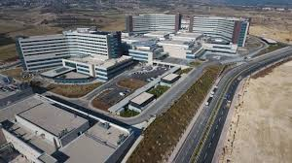
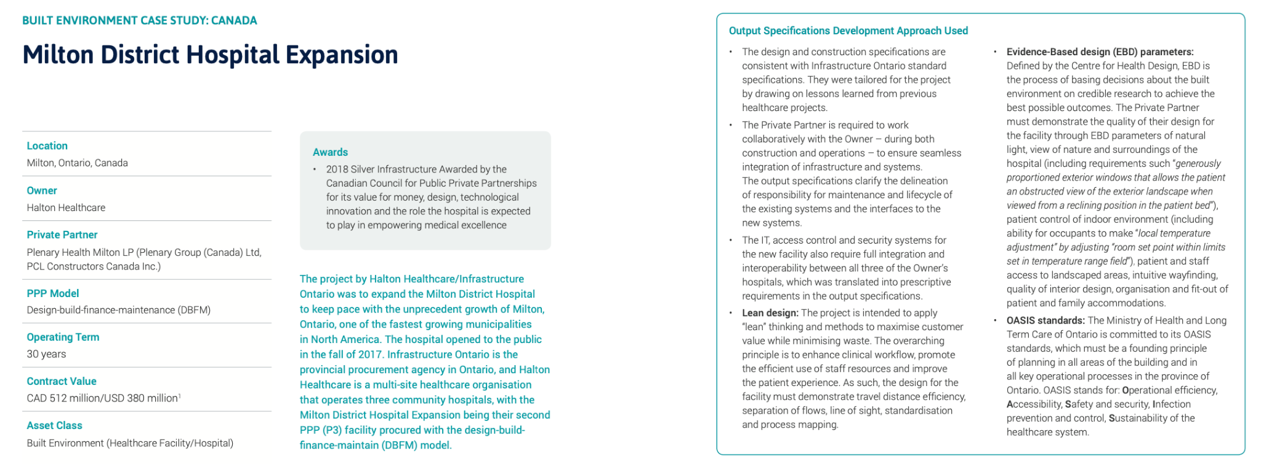




Insights from Similar Redevelopment Projects
Case study 1: Milton District Hospital, Ontario, Canada
Enhancing patient-centred care
Creating healing environments
Sustainability
Community integration
Notes:
To illustrate the practical application of evidence-based design in Canadian healthcare, let's examine the Milton District Hospital expansion project. Completed in 2017, this development serves as a prime example of how evidence-based design principles can be successfully implemented in healthcare infrastructure renovation and expansion.This project, with a value of C$512 million, significantly expanded the existing facility from 125,000 to 455,000 square feet, more than tripling its size.
Patient-centered care was enhanced by more than doubling inpatient capacity, introducing predominantly single-patient rooms, and expanding critical services.
The project emphasized creating healing environments through the integration of diverse garden spaces, abundant natural light, and views of nature.
Sustainability was a key focus, with the hospital targeting LEED Silver certification and incorporating numerous eco-friendly features.
The design also prioritized future-proofing and flexibility, allowing for expansion over a 50-year horizon.
Community integration was achieved through improved accessibility and architectural harmony with the surrounding area.
Throughout the redevelopment, operational continuity was maintained, ensuring uninterrupted patient care.
This evidence-based approach to design, grounded in research on patient outcomes and healthcare efficiency, has created an environment that reduces stress and promotes healing. The Milton District Hospital project demonstrates how evidence-based design principles can be effectively applied in a Canadian context, balancing immediate healthcare needs with long-term sustainability and community integration.

Slide 15
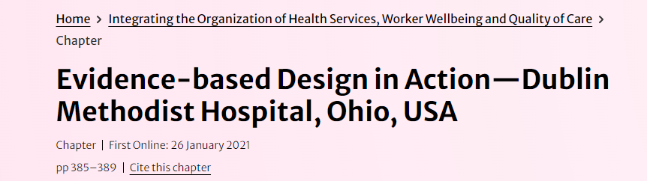
Insights from Similar Redevelopment Projects
Case study 2: Dublin Methodist Hospital , Ohio, USA
Notes:
I'd like to share another remarkable example of evidence-based design in action: the Dublin Methodist Hospital in Ohio. From the very beginning, the hospital's leadership challenged their design team to base every significant decision on the best available evidence. This approach led to a facility that not only fits seamlessly into its community but also significantly enhances patient and staff experiences.
They followed a comprehensive evidence-based design process, rigorously moving from defining clear goals and interpreting credible research to measuring outcomes after the building was occupied. This ensured that each design choice was grounded in solid evidence.
To revolutionize healthcare delivery, they created advisory groups with leaders from various disciplines. This collaborative effort led to innovative design solutions without being hindered by existing organizational politics.
For patient and staff well-being, the hospital incorporated 13 healing gardens and an extensive collection of nature photography, creating restorative environments that promote emotional and spiritual health. They emphasized natural light and views, which helped reduce patient depression, shorten hospital stays, and decrease the need for pain medication. Designated areas for staff retreat enhanced job satisfaction and reduced burnout.
In terms of quality of care, they implemented standardized and same-handed patient rooms to reduce errors and improve efficiency. Safety features like prominent handwashing stations encouraged better hygiene practices, lowering infection rates. While the concept of acuity-adaptable rooms—allowing patients to stay in the same room as their care needs change—highlighted the importance of aligning design innovations with organizational practices.
A post-occupancy evaluation in 2015 confirmed improvements in patient satisfaction, staff efficiency, and overall quality of care, validating their evidence-based approach.

Slide 16
Application to South Niagara Hospital
South Niagara Hospital's focus on EBD is well-supported by research and practical examples. e.g.
Using performance frameworks like the Institute of Medicine framework and Donabedian’s model can ensure that the hospital's design aligns with these principles, enhancing care quality and efficiency.
Enhance safety and infection
By incorporating single-patient rooms
Reduce stress
By including natural elements like healing gardens and increased natural light.
Staff effectiveness
By creating ergonomic workspaces and efficient layouts for nursing stations and care areas.
Patient and family support
By integrating family zones within patient rooms and providing comfortable public areas with amenities.
Notes:
Based on our literature review, we can deduce that South Niagara Hospital is actively considering evidence-based design principles. For instance, they plan to enhance safety by incorporating single-patient rooms to reduce hospital-acquired infections and using low-toxicity materials to improve air quality. To reduce patient stress, they're integrating natural elements like healing gardens and increasing natural light through architectural features. Staff effectiveness is being addressed by creating ergonomic workspaces and efficient layouts.
Lastly, using performance frameworks like the Institute of Medicine framework and Donabedian’s model can ensure that the hospital's design aligns with these principles, enhancing care quality and efficiency.
We will now take a look at the the indicators that we are proposing

Slide 17
03
Proposed Indicators
Notes:
Next we will be speaking about performance measurement indicators to monitor progress toward South Niagara’s objectives

Slide 18
Proposed Indicators (1/4)
Indicator | Definition | Numerator | Denominator | Rationale | Refresh Frequency
Patient Satisfaction Score | Measures a patient’s overall satisfaction with their healthcare experience at South Niagara Hospital. | Number of Positive Responses | Total Survey Responses | Measures progress against South Niagara Hospital’s core goal of improving patient experience Patient satisfaction score is a key indicator in evaluating healthcare quality and patient experience Patient satisfaction correlates with better health outcomes, treatment adherence, and patient safety | Annually
Inpatient Fall Rate | Measures the number of falls that occur relative to patient volume. It is expressed as the number falls per 1,000 patient days. | Total number of inpatient falls that occur within the quarterly period | Total number of patient days during that same period. | Measures progress against core goal of improving accessibility with a particular focus on older adults Falls are one of the most commonly reported incidents in hospitals, especially among seniors Measures effectiveness of hospital’s evidence-based design features and helps ensure a safe, accessible environment. | Quarterly
Notes:
Given that patient experience is one core goal of South Niagara Hospital, we recommend that the hospital measures patient satisfaction using standardized surveys to measure the overall experience of patients and assess the quality of care they received. The primary survey question should be: “Please rate your overall satisfaction with our healthcare facility on a scale of 1 to 5” (Bhawika, 2024). By focusing on patient satisfaction, the hospital can measure whether patients feel cared for and supported. Research reveals satisfied patients have better health outcomes, adhere more closely to treatment plans, and experience fewer complications (Dubé-Linteau & Institut de la statistique du Québec, 2017). Surveys will be sent every day to discharged patients as research reveals surveys collected shortly after a care experience are more useful to healthcare organizations compared to those that are sent later. However, surveys will be refreshed on an annual basis (Dubé-Linteau & Institut de la statistique du Québec, 2017).
In addition, we recommend the hospital also tracks inpatient falls that occur each quarter as accessibility is another core objective of theirs (Niagara Health, n.d.). Falls among inpatients are one of the most commonly reported incidents in hospitals and lead to high healthcare costs, especially amongst seniors, a primary group of patients that South Niagara hospital is expecting to serve (Bernet et al., 2024). By tracking the fall rate, the hospital can assess whether its evidence-based design features—such as low-glare flooring and accessible seating are effective in reducing patient falls (Niagara Health, n.d.). This will be reviewed on a quarterly basis as a part of the quality improvement plan which will allow the hospital to identify issues, make adjustments in a timely manner, and ensure it is providing an accessible environment for senior patients and others.

Slide 19

Proposed Indicators (2/4)
Indicator | Definition | Numerator | Denominator | Rationale | Refresh Frequency
Number of Patients Registered for NH Navigator | Measures the number of patients who sign up for access to the Niagara Health (NH) Navigator app | Number of patients who sign-up for access to NH Navigator | N/A | Measures progress against South Niagara’s goals of operational excellence and being adaptable, flexible, and responsive High registrations indicate effective engagement with digital tools Registered patients have timely access to health information (e.g., test results) Enhances patient engagement, satisfaction, and overall care experience | Annually
Staff Turnover Rate | Measures the percentage of staff who leave the hospital over a specific period | The number of staff who left the hospital during the quarterly period | The average number of staff employed during the quarterly period | Measures progress against goals of employee satisfaction and operational excellence. Impacts hospital’s goal to achieve WELL® Certification High turnover can lead to disrupted workflows, lower quality of care, and increased financial costs | Quarterly
Notes:
Also, we recommend measuring the number of patients registered for Niagara Health Navigator, South Niagara’s digital health application . This indicator measures progress against the hospital goals of being adaptable, flexible, and responsive and its goal of operational excellence as improved integration of technology including this app is listed as an initiative under both goals (Niagara Health, n.d.). By monitoring NH Navigator registrations, the hospital can track how well patients are adopting this digital health tool and if there are any barriers to adoption that they can address to ensure that they are making progress in integrating technology (Niagara Health, n.d.). We recommend refreshing this indicator annually as technology adoption often grows gradually as patients become accustomed to new platforms.
Furthermore, we recommend monitoring staff turnover rates. Staff turnover is a key indicator that measures progress against the hospitals goals of employee satisfaction and operational health . Stressful working conditions in hospitals can sometimes lead to a high turnover rate (Mathisen et al., 2021). A high turnover rate often disrupts workflows, increases financial costs, and can lead to burnout among remaining staff, all of which negatively affect the quality of care patients receive (Mathisen et al., 2021). South Niagara also aims to obtain WELL® Certification, which emphasizes staff well-being. To stay on track toward achieving this goal, the organization needs to measure whether the organization has a high staff turnover, as it could indicate stressful conditions and a decline in staff well-being Therefore, monitoring turnover rates quarterly allows the hospital to identify issues early and make the necessary adjustments to increase retention and work towards some of its established goals.

Slide 20
Proposed Indicators (3/4)
Indicator | Definition | Numerator | Denominator | Rationale | Refresh Frequency
Hospital Readmission Rate | The percentage of patients who are readmitted to the hospital within 30 days of discharge. | Number of patients readmitted within 30 days of discharge during the measurement period. | Total number of patients discharged during the same period. | Supports South Niagara Hospital’s core goal of operational excellence by tracking the effectiveness of care coordination and discharge planning. Reducing readmissions ensures continuity of care, especially important for the hospital's focus as a Centre of Excellence in Complex Care. Lower readmission rates improve patient outcomes and reduce costs associated with repeat hospital visits. | Quarterly
Emergency Department (ED) Wait Time | The average time patients spend waiting from arrival to initial assessment in the Emergency Department. | Total time (in minutes) from arrival to assessment for all patients | Total number of patients seen in the ED | Enhances patient experience by reducing wait times, aligning with South Niagara Hospital’s goal to improve patient and family satisfaction. Efficient patient flow is critical for managing emergency situations and reducing overcrowding. Helps optimize staff allocation and resources, contributing to operational excellence. | Monthly
Notes:
We recommend monitoring the hospital readmission rate as a key indicator of South Niagara Hospital's performance. This metric aligns with the hospital’s goals of operational excellence and quality care by assessing the effectiveness of care coordination, discharge planning, and follow-up services. As a Centre of Excellence in Complex Care, it is crucial for South Niagara to minimize readmissions, which can be indicative of gaps in care that need to be addressed (Van Walraven et al., 2011). Reducing readmission rates will not only improve patient outcomes but also contribute to cost savings and better resource management. High readmission rates can lead to overcrowded facilities and strained resources, making it difficult to provide timely care to new patients. By tracking readmissions, South Niagara can identify trends, understand the underlying causes, and implement strategies to enhance patient care and support post-discharge. For example, this could involve improving patient education, strengthening follow-up procedures, or integrating community resources for better continuity of care (Joynt & Jha, 2012). We recommend refreshing this indicator quarterly to allow the hospital to make timely adjustments to care processes and discharge protocols, ensuring the organization remains on track toward achieving its strategic objectives (Niagara Health, n.d.).
Another key indicator we propose is the average Emergency Department (ED) wait time. This metric is critical for evaluating South Niagara’s operational efficiency and aligns with the hospital’s goals of improving patient and family experience. Efficient patient flow through the ED is essential, particularly in a facility that prioritizes quick, high-quality care. Long wait times can lead to patient dissatisfaction and delays in receiving necessary care, which can negatively impact health outcomes, especially in emergency situations (McClelland et al., 2012). Monitoring ED wait times will help the hospital assess the effectiveness of current staffing levels, resource allocation, and patient triage processes. For South Niagara, where the design includes features to enhance patient navigation and accessibility, maintaining low wait times will ensure these architectural elements effectively contribute to smoother operations and better patient experiences (Carpman & Grant, 2016). By tracking this indicator monthly, South Niagara Hospital can make data-driven decisions on resource management and staffing, allowing for adjustments during peak times to maintain a high standard of care. Consistently reducing ED wait times will help the hospital meet its operational excellence goals and enhance patient satisfaction, ultimately contributing to a more responsive and efficient healthcare environment (Niagara Health, n.d.).

Slide 21
Proposed Indicators (4/4)
Indicator | Definition | Numerator | Denominator | Rationale | Refresh Frequency
Energy Consumption Per Square Foot | The total energy consumed per square foot of hospital space. | Total energy consumption (kWh) | Total square footage of the hospital | Aligns with South Niagara Hospital’s commitment to environmental leadership and sustainability, including goals for LEED certification. Efficient energy use supports cost savings and reduces the hospital’s carbon footprint, contributing to long-term sustainability. Monitoring energy consumption can help identify opportunities for improvement in energy efficiency and sustainability practices. | Annually
Medication Error Rate | The rate of medication errors reported in relation to the total number of medication doses administered. | Number of reported medication errors | Total number of medication doses administered | Ensures patient safety, aligning with South Niagara Hospital’s focus on high-quality care, especially for complex cases. Reducing medication errors can lead to improved outcomes, increased patient satisfaction, and lower costs from adverse events. Frequent monitoring allows quick identification of trends and the ability to implement safety improvements promptly. | Monthly
Notes:
We propose monitoring energy consumption per square foot as a critical indicator of South Niagara Hospital's commitment to environmental leadership and sustainability. As the hospital aims to achieve LEED certification, tracking energy usage helps ensure adherence to green building standards, promoting cost savings and reducing the hospital’s carbon footprint (U.S. Green Building Council, 2019). Efficient energy use is not just a sustainability goal but also aligns with operational excellence, as reducing utility expenses can free up resources for patient care and other essential services. Hospitals are among the most energy-intensive facilities, often operating 24/7 with high demands for heating, cooling, and equipment operation. By continuously monitoring energy consumption, South Niagara can identify inefficiencies, optimize energy usage, and implement energy-saving initiatives like improved insulation, efficient lighting, and renewable energy sources (Setra Systems, 2017). These practices support the hospital’s goals of environmental sustainability and cost management. Additionally, energy consumption data can help in compliance with LEED standards, which recognize facilities that achieve excellence in energy efficiency and resource management (Katz, 2011). We recommend refreshing this indicator annually, with monthly tracking to allow the hospital to identify trends and make timely adjustments. Continuous monitoring ensures that the hospital can maintain high performance in energy efficiency and remain on track toward its sustainability goals.
Another key indicator we recommend is the medication error rate. This metric measures South Niagara Hospital’s success in ensuring patient safety, a core priority for the facility. Medication errors can lead to adverse patient outcomes, increased costs, and legal repercussions, making this indicator essential for maintaining high standards of care (Institute for Safe Medication Practices, 2018). Monitoring this rate can help South Niagara identify patterns, understand the causes of errors, and implement preventive measures such as improved staff training, better communication protocols, and enhanced medication management systems. Given South Niagara’s focus on complex care, accurate and safe medication administration is critical. Tracking medication errors can reveal areas where safety protocols may need to be reinforced, ensuring the hospital continues to deliver high-quality care. Additionally, with plans to achieve WELL® Certification, which emphasizes staff and patient well-being, monitoring medication errors aligns with broader safety goals and ensures a safer, more supportive healthcare environment (WELL Building Standard, 2020). We recommend refreshing this indicator monthly to ensure that issues can be addressed promptly and that safety protocols are continuously evaluated and improved. Regular monitoring allows South Niagara Hospital to maintain its high standards for patient safety and operational excellence.

Slide 22
04
Recommendation and Next Steps

Slide 23
Recommendations
Structured data collection plan for each performance indicator
Increase patient engagement with NH Navigator
Data Collection and Analysis
Technology Integration
Environmental Sustainability Efforts
Staff Training and Support
Communication and Stakeholder Engagement
Energy management systems to monitor consumption per square foot, identify high-usage areas, and implement energy-saving initiatives
Training programs focused on key areas like medication safety, effective use of NH Navigator, and energy-saving practices
communication plan that includes regular updates on performance indicators and hospital progress to stakeholders.
Notes:
Our first recommendation is to implement a structured data collection plan for each performance indicator. This includes using reliable data sources and standardized methods across all metrics, such as patient satisfaction, readmission rates, medication error rates, and energy consumption. Consistent and accurate data collection will allow South Niagara to monitor its progress in real-time. This is crucial for addressing emerging issues, such as high readmission rates or increased medication errors, and making timely adjustments to care processes. By regularly analyzing this data, the hospital can ensure it is on track to meet its core goals of quality care and operational efficiency.
Our next recommendation focuses on expanding and optimizing the integration of technology. Specifically, we suggest increasing patient engagement with the NH Navigator digital health platform by enhancing its usability and addressing any barriers to adoption. Additionally, continuous feedback should be used to refine the tool and improve patient experiences. This aligns with South Niagara’s goals of adaptability, flexibility, and operational excellence. Effective use of digital tools like NH Navigator can streamline communication, improve appointment scheduling, and provide seamless access to patient data, ultimately leading to better patient outcomes and a more efficient workflow.
We recommend that South Niagara prioritize its sustainability efforts by integrating advanced energy management systems. This includes monitoring energy consumption per square foot, identifying high-usage areas, and implementing energy-saving initiatives like LED lighting, efficient HVAC systems, and even exploring renewable energy options, such as solar panels. Sustainability is a core focus for South Niagara, and achieving LEED certification is a key goal of this project. By adopting energy-efficient practices, the hospital can reduce utility costs, improve resource management, and lead the way in environmental responsibility. This not only aligns with sustainability objectives but also contributes to cost savings that can be redirected towards patient care.
Another critical recommendation is to enhance staff training and support. Regular training programs should be offered to cover areas like medication safety, effective use of digital health tools, and energy-saving practices. We also suggest introducing wellness programs to support staff well-being, which will be essential as the hospital works toward WELL® Certification. Effective training ensures that staff are equipped to minimize errors, improve patient care, and contribute to sustainability efforts. Well-supported and engaged staff are more likely to stay, which reduces turnover rates and ensures a consistent quality of care. This directly supports South Niagara's strategic goals of operational excellence and staff well-being.
Our final recommendation is to develop a transparent communication plan. This should include regular updates on performance indicators and hospital progress through various channels, such as newsletters, town hall meetings, and online dashboards. Engaging with stakeholders, including patients, staff, and community partners, will ensure the redevelopment aligns with their needs and expectations.Open communication fosters trust and transparency. By engaging patients, staff, and the community, the hospital can gain valuable insights that help refine strategies and improve patient experiences. Regular feedback also ensures that the hospital’s redevelopment stays aligned with the needs of those it serves, reinforcing South Niagara’s commitment to high-quality, patient-centered care.

Slide 24
Next Steps
01
02
03
04
05
Finalize and Implement Data Monitoring Systems
Conduct Quarterly Performance Reviews
Launch Technology Adoption Campaign
Develop a Long-term Sustainability Roadmap
Establish a Staff Well-being and Training Program
Notes:
The first step is to finalize the performance indicators and install robust data monitoring systems. This involves setting up advanced energy metering, digital health platforms, and data analytics tools to ensure seamless integration across the hospital. Having precise and efficient data monitoring will allow South Niagara to track key metrics such as patient satisfaction, readmission rates, and energy consumption effectively. By establishing these systems now, the hospital can streamline data collection and ensure that information is accurate and up-to-date. This will be critical for making informed, data-driven decisions that align with strategic objectives. We recommend beginning the installation and integration of these systems immediately, with a comprehensive review scheduled six months after launch to assess performance and make any necessary adjustments.
Next, we propose scheduling quarterly performance review meetings. These meetings should bring together leadership, clinical staff, and patient representatives to discuss data trends, identify areas for improvement, and ensure alignment with the hospital’s strategic goals. Regular review meetings will provide an opportunity to assess the effectiveness of current initiatives, address emerging issues, and ensure that the hospital remains on track. This will foster a culture of continuous improvement, ensuring that adjustments can be made promptly based on real-time data. These meetings should be scheduled quarterly, starting in the first quarter after the hospital opens. Each review should include a report summarizing key findings, challenges, and next steps.
We recommend launching a patient outreach campaign to promote the use of the NH Navigator digital health tool. This will involve creating educational resources, such as workshops, digital tutorials, and community events, to ensure patients are informed about how to use the platform effectively. Patient engagement with digital health tools is essential for improving care coordination and operational efficiency. By addressing barriers to adoption early, the hospital can ensure smooth integration of technology, leading to better patient outcomes and a more efficient healthcare environment. Begin this outreach program in the first quarter, with ongoing adjustments based on patient feedback. Regular updates should be provided to track engagement levels and make improvements where needed.
We recommend creating a detailed sustainability roadmap that outlines specific goals for energy efficiency, waste reduction, and green technology adoption. This roadmap should include a plan for implementing renewable energy options, such as solar panels, and regular assessments of environmental impact. Achieving LEED certification is a key goal for South Niagara, and a clear sustainability plan will help the hospital stay on course. Reducing energy consumption and waste not only supports environmental stewardship but also results in significant cost savings that can be reinvested into patient care. Develop this roadmap within the next three months, with quarterly progress checks to ensure that the hospital remains on track for LEED certification. Assign a dedicated team to oversee and report on sustainability initiatives.
Finally, we propose establishing a comprehensive staff training and well-being program. This program should cover essential areas like medication safety, digital tool utilization, and energy-saving practices, while also including wellness initiatives to support staff morale and reduce turnover. Effective training and support are critical for minimizing errors, improving patient care, and maintaining a positive work environment. By investing in staff well-being, South Niagara can reduce turnover rates, ensure consistent quality of care, and progress toward its goal of WELL® Certification, which emphasizes a supportive and healthy workplace. Develop and launch the training program within six months, with ongoing training sessions scheduled throughout the year. Evaluate the program’s impact regularly and adjust based on staff feedback and performance data.

Slide 25
Thank you
Any Questions?

Slide 26
Reference
Aljunid, S. S., Shukri, N. N. H. M., Taib, M. Z., & Abu Samah, Z. (2020). Determinants of patient satisfaction on interior design quality of public hospitals in Malaysia. Malaysian Journal of Public Health Medicine, 20(2), 233–241. https://doi.org/10.37268/mjphm/vol.20/no.2/art.800
Bernet, N. S., Everink, I. H. J., Hahn, S., Bauer, S., & Schols, J. M. G. A. (2024). Comparing risk-adjusted inpatient fall rates internationally: Validation of a risk-adjustment model using multicentre cross-sectional data from hospitals in Switzerland and Austria. BMC Health Services Research, 24(1), 331. https://doi.org/10.1186/s12913-024-10839-x
Bhawika. (2024, February 16). How to calculate the patient satisfaction score? Zonka. https://www.zonkafeedback.com/blog/calculate-patient-satisfaction-score
Carpman, J. R., & Grant, M. A. (2016). Design that cares: Planning health facilities for patients and visitors. John Wiley & Sons.
Dubé-Linteau, A., & Institut de la statistique du Québec. (2017). Measuring patient experience through surveys: From concepts to best practices. In G. Neill, P. Caris, Sematos, & A.-M. Roy (Eds.), Études et documents [Report]. Institut de la statistique du Québec. https://statistique.quebec.ca/en/fichier/measuring-patient-experience-through-surveys-from-concepts-to-best-practices.pdf
Global Infrastructure Hub. (n.d.). Case study: Milton District Hospital expansion. https://cdn.gihub.org/umbraco/media/2750/case-study-milton-district-hospital-expansion.pdf
Halawa, F., Madathil, S. C., Gittler, A., & Khasawneh, M. T. (2020). Advancing evidence-based healthcare facility design: A systematic literature review. Health Care Management Science, 23(3), 453–480. https://doi.org/10.1007/s10729-020-09506-4

Slide 27
Reference
Infrastructure Ontario. (n.d.). Value for money assessment: Milton District Hospital expansion project. https://www.infrastructureontario.ca/48e225/contentassets/873823668c834bcc8cad4d1be9752b9b/milton_vfm_final.pdf
Institute for Safe Medication Practices. (2018). Improving medication safety in hospitals. Retrieved from https://www.ismp.org
Joynt, K. E., & Jha, A. K. (2012). Thirty-day readmissions—Truth and consequences. New England Journal of Medicine, 366(15), 1366-1369.
Katz, A. (2011). Healthy and green with LEED for healthcare. Facilities Management Insights. Retrieved from https://www.facilitiesnet.com
Mathisen, J., Nguyen, T. L., Jense, J. H., Rugulies, R., & Rod, N. H. (2021). Reducing employee turnover in hospitals: Estimating the effects of hypothetical improvements in the psychosocial work environment. Scandinavian Journal of Work, Environment & Health, 47(6), 456–465. https://doi.org/10.5271/sjweh.3969
McClelland, M., Lazar, D., & Sears, J. (2012). Improving emergency department patient flow. Journal of Healthcare Management, 57(2), 81-92.
Niagara Health. (n.d.). South Niagara Hospital Project. Retrieved from https://www.niagarahealth.on.ca
Setra Systems. (2017). How are power meters used in LEED projects? Retrieved from https://www.setra.com
The Center for Health Design. (2011). What is evidence-based design (EBD)? Retrieved from https://www.healthdesign.org/certification-outreach/edac/about-ebd

Slide 28
Reference
U.S. Green Building Council. (2019). LEED v4 for building design and construction. Retrieved from https://www.usgbc.org
Van der Zwart, J., & Pilosof, N. P. (2020). Evidence-based design for healthcare work environments. In L. Tevik Løvseth & A. H. de Lange (Eds.), Integrating the organization of health services, worker wellbeing and quality of care: Towards healthy healthcare (pp. 245–62). Cham: Springer International Publishing. https://doi.org/10.1007/978-3-030-59467-1_11
Van der Zwart, J. (2020). Evidence-based design in action—Dublin Methodist Hospital, Ohio, USA. In L. Tevik Løvseth & A. H. de Lange (Eds.), Integrating the organization of health services, worker wellbeing and quality of care: Towards healthy healthcare (pp. 385–9). Cham: Springer International Publishing. https://doi.org/10.1007/978-3-030-59467-1_23
Van Walraven, C., Bennett, C., Jennings, A., Austin, P. C., & Forster, A. J. (2011). Proportion of hospital readmissions deemed avoidable: A systematic review. CMAJ, 183(7), E391-E402.
WELL Building Standard. (2020). Enhancing safety and well-being in healthcare facilities. Retrieved from https://www.wellcertified.com

